Slide 1
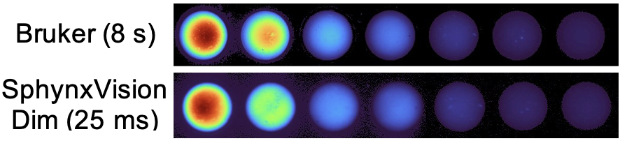
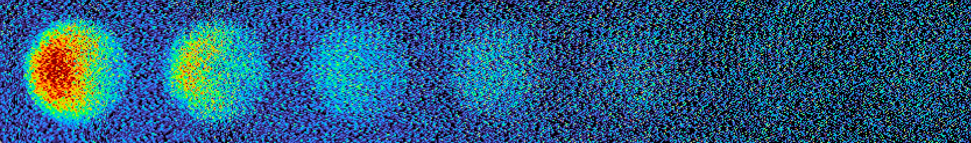
Quantitative Comparison to Leading Imaging Systems
Othe
Other
Other System (8 s)
SphynxVision, Dim (25 ms)
Other System (25 ms)
Bruker (25 ms)
Tissue phantom doped with doxorubicin (10 ng-10 ug/mL)
Tissue phantom doped
with doxorubicin (10 ng-10 µg/mL)
Other Systems

